Slide 1
Interaksi Manusia dan Komputer (IMK)
Tim Dosen IMK
KK SIDE
THE USER INTERFACE (UI) DESIGN PROCESS
GAME INTERFACE DESIGN

Slide 2
Tujuan
Setelah mengikuti materi ini mahasiswa dapat:
Mahasiswa/i dapat mengenal tren desain antarmuka game.

Slide 3
Definition of Game

Slide 4
What is a Game? (1 of 3)
Movie? (ask: why not?)
→ no interaction, outcome fixed
Toy? (has interaction … ask: why not?)
→ no goal, but still fun (players can develop own goals)
Puzzle? (has goal + interaction … ask: why not?)
→ strategy and outcome is the same each time
“A computer game is a software program in which one or more players make decisions through the control of game objects and resources, in pursuit of a goal.”
Chapter 2.2, Introduction to Game Development

Slide 5
What is a Game (2 of 3)
A Computer Game is a Software Program
Not a board game or sports
Consider: chess vs. soccer vs. Warcraft
Ask: What do you lose? What do you gain?
Lose: 1) physical pieces, 2) social interaction
Gain: 1) real-time, 2) more immersive, 3) more complexity
A Computer Game involves Players
“No, Duh”. But stress because think about audience. The game is not for you but for them.
Don’t just think about your story or the graphics or the interface, but consider the players.
Ex: complicated flight simulator (say, you are a flying geek) but audience is beginner
Based on Tutorial: What is a Good Game?, by Mark Overmars

Slide 6

What is a Game (3 of 3)
Playing a Game is About Making Decisions
Ex: what weapon to use, what resource to build
Can be frustrating if decision does not matter
Want good gameplay (next major topic)
Playing a Game is About Control
Player wants to impact outcome
Uncontrolled sequences can still happen, but should be sparing and make logical
Ex: Riven uses train system between worlds
A Game Needs a Goal
Ex: Defeat Ganandorf in Zelda
Long games may have sub-goals
Ex: recover Triforce first, then Sword of Power
Without game goals, a player develops his/her own (a toy)
Based on Tutorial: What is a Good Game?, by Mark Overmars

Slide 7
What a Game is Not (1 of 2)
A bunch of cool features
Necessary, but not sufficient
May even detract, if not careful, by concentrating on features not game
A lot of fancy graphics
Games need graphics just as hit movie needs special effect … but neither will save weak idea
Again, may detract
Game must work without fancy graphics
Suggestion: should be fun with simple objects
“When a designer is asked how his game is going to make a difference, I hope he … talks about gameplay, fun and creativity – as opposed to an answer that simply focuses on how good it looks” – Sid Meier (Civilizations, Railroad Tycoon, Pirates)
Based on Chapter 2, Game Architecture and Design, by Rollings and Morris

Slide 8
What a Game is Not (2 of 2)
A series of puzzles
All games have them
But not gameplay in themselves
Puzzles are specific, game systems spawn more generic problems
An intriguing story
Good story encourages immersion
But will mean nothing without gameplay
Example: Baldur’s Gate, linear story. Going wrong way gets you killed. But not interactive. Interaction in world all leads to same end.
Based on Chapter 2, Game Architecture and Design, by Rollings and Morris

Slide 9
Games are Not Everything
Most important … is it fun, compelling, engaging?
And these come from a superset of games
Computers are good at interactivity
Allow for interactive fun
Interactive Media and Game Development ☺
Examples:
SimCity - very compelling, but mostly no goals. More of toy than a game, but still fun.
Grim Fandango - good visuals, story, etc. But need to do puzzles to proceed. Could have skipped to just watch story. Would still have been fun without the gameplay.

Slide 10
What is a game?
What's the difference between . . . ?
Toys
Just play, no rules or goal
Puzzles
A goal, but usually no rules (e.g. Rubik’s cube)
Games
Play, goal, rules

Slide 11
Play
Participatory form of entertainment
Compare to books, theater, film, which are not interactive.
Pretending – the Magic Circle
Important even in a physical game like soccer. Why?
The magic circle comes into existence when players join the game and agree to abide by the rules.

Slide 12
Goal
Also called the object of the game
Might or not be achievable
Examples of games with unachievable goals?
Defined by the rules, is arbitrary
Must be nontrivial and present a challenge
Victory conditions
Game does not always end when victory conditions are achieved
Can specify loss conditions also (or instead)

Slide 13
Rules
Definitions and instructions that players agree to accept
Semiotics--meaning and relationships between symbols
Gameplay--challenges and actions
Sequence of play
Goals
Termination
Metarules--exceptions or changes to rules

Slide 14
The Language of Games
Why do we play?
Not a designer’s problem
What is the nature of games?
Not a designer’s problem
How is a game formed of parts?
A designer’s problem

Slide 15
Types of Game UI

Slide 16
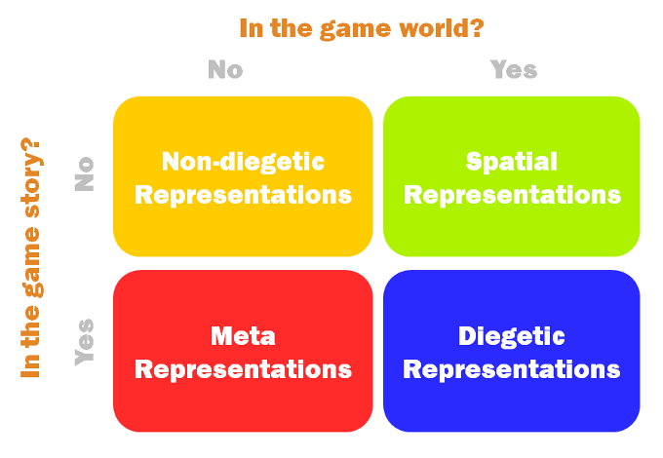
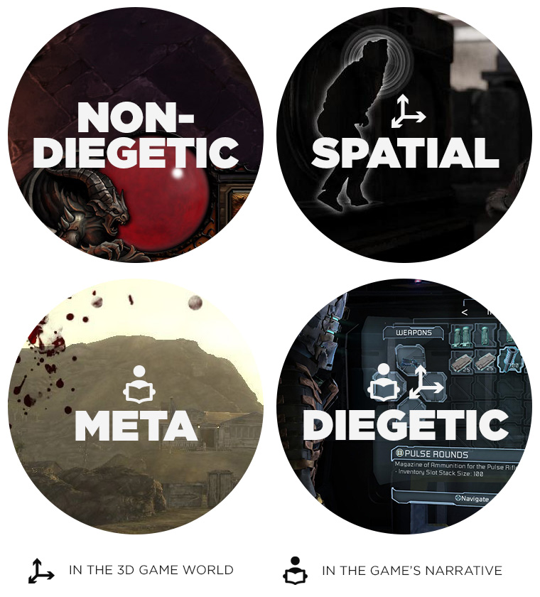
Game Interface Type

Slide 17
Seven Stages of Action
Execution
Intention to act
Sequence of action
Execution of action sequence
Evaluation
Evaluating interpretations
Interpreting perceptions
Perceiving states

Slide 18
Seven Stages of Action
A goal is formed
Models the desired state
The desired result of an action
Examples:
Have a glass of water in hand
Capture a queen
Taste ice cream

Slide 19
Seven Stages of Action
Goals turned into intentions to act
Specific statements of what is to be done

Slide 20
Seven Stages of Action
Intentions put into an action sequence
The order internal commands will be performed

Slide 21
Seven Stages of Action
The action sequence is executed
The player manipulates control variables

Slide 22
Seven Stages of Action
The state of the game is perceived
State variables are revealed via the interface

Slide 23
Seven Stages of Action
Player interprets their perceptions
Interpretations based upon a model of the system

Slide 24
Seven Stages of Action
Player evaluates the interpretations
Current states are compared with intentions and goals

Slide 25
Seven Stages of Action
Scales to…
…an individual mechanic
A “primary element”
Examples:
Move
Shoot
Talk
…an entire game
A generalized model of interaction

Slide 26
Designer and Player Models
Systems are built from designer mental models
Design models may only anticipate player goals

Slide 27
Designer and Player Models
Players build mental models from mechanics
Based upon interactions with the system image
The reality of the system in operation
Not from direct communication with designers
Player and designer models can differ significantly

Slide 28
Goal in Games

Slide 29
The hierarchy of challenges Adams & Rollings
Complete the game
Finish a mission
Finish a sub-mission
Finish an atomic challenge
Player will usually be thinking about current atomic challenge.
Awareness of higher-level challenges creates anticipation.

Slide 30
Challenges
Victory conditions and atomic challenges are usually explicit.
Intermediate challenges are usually implicit.
Players get tired of just following instructions.
"The most interesting games offer multiple ways to win" -- Adams & Rollings, p. 284
More than one way to accomplish intermediate challenges
Capture the flag (p. 284): defensive approach, aggressive approach, stealth approach

Slide 31
Menu Flow Design

Slide 32
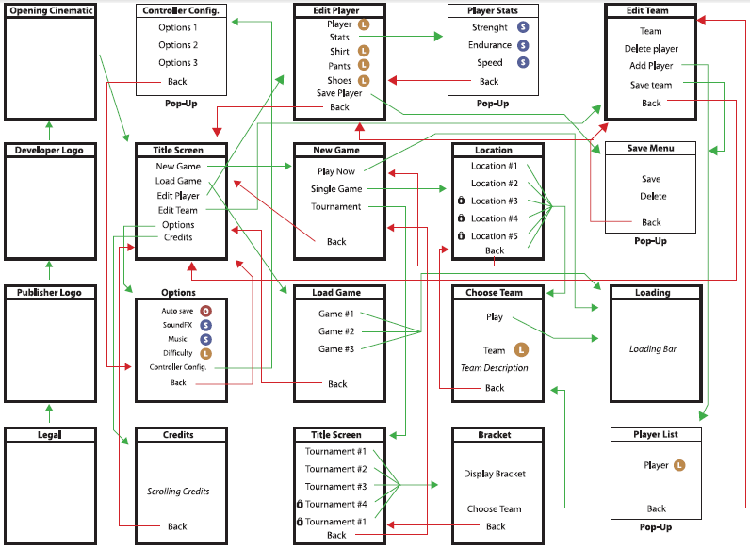
PLANNING MENU FLOW

Slide 33
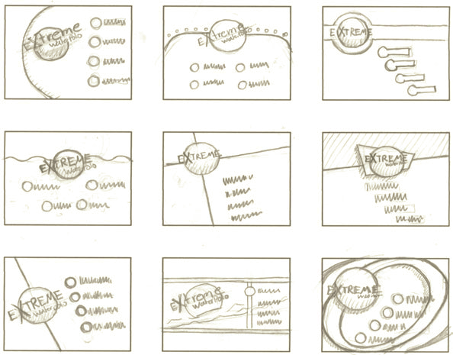
SKETCHES

Slide 34
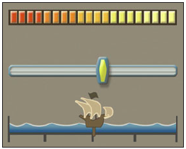

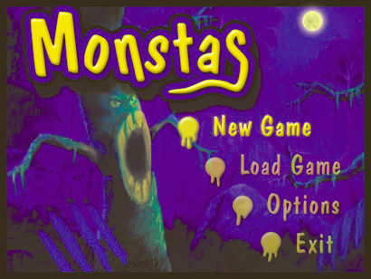
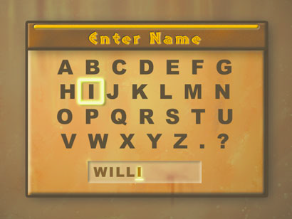
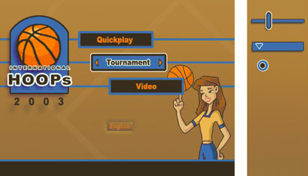
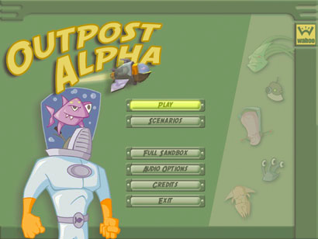
COMPONENTS DESIGN
button
slider

Slide 35
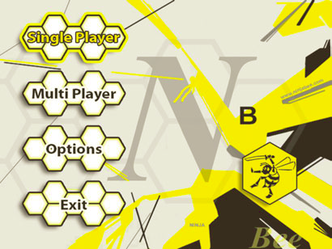

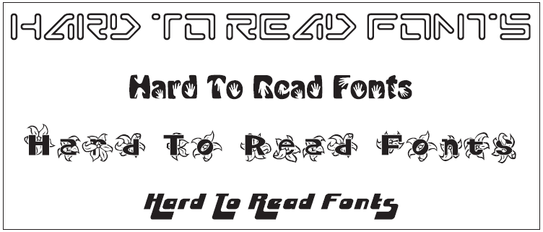
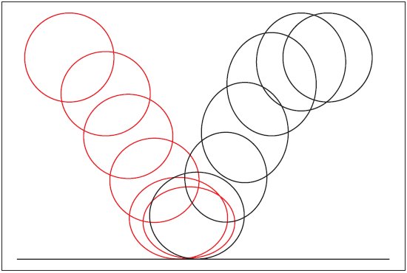
BASIC DESIGN PRINCIPLES
Using color harmony
Visual organization
Create a focal point
Use text carefully
Watch the animation
Icons, icons and icons

Slide 36
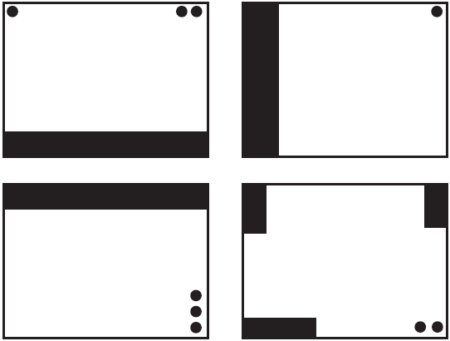
PLANNING FOR HUD (HEADS-UP DISPLAY)
HUD is short for Heads Up Display, which refers to the interface that is displayed during game play—stuff like the radar, health meters, and score.

Slide 37
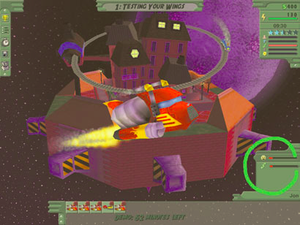
An interface with a dynamic HUD that only appears when the player needs it

Slide 38
Technical Requirements and Tricks

Slide 39
Making games fun (Adams & Rollings)
50% Avoiding errors--bad programming, bad music and sound, bad art, bad user-interfaces, bad game design. "Basic competence will get you up to average."
35% Tuning and polishing--attention to detail
10% Imaginative variations--level design
4% True design innovation--the game's original idea and subsequent creative decisions
1% An unpredictable, unanalyzable, unnamable quality--"luck, magic, or stardust"
Do you believe them?

Slide 40
Making games fun (Adams & Rollings)
50% Avoiding errors
35% Tuning and polishing
10% Imaginative variations
4% True design innovation
1% Luck, magic, or stardust
Implications:
A well-tuned game with no major problems and interesting levels but no new ideas could be 95% fun.
A novel game idea that is (very) poorly executed could be only 4% fun.
Do you believe them?

Slide 41
Finding the fun factor (Adams & Rollings)
Gameplay comes first--give people fun things to do
Get a feature right or leave it out
Design around the player
Know your target audience
Abstract or automate parts that aren't fun
Be true to your vision
Strive for harmony, elegance, and beauty
How to become rich and famous . . .

Slide 42
Interactive Mockups

Slide 43
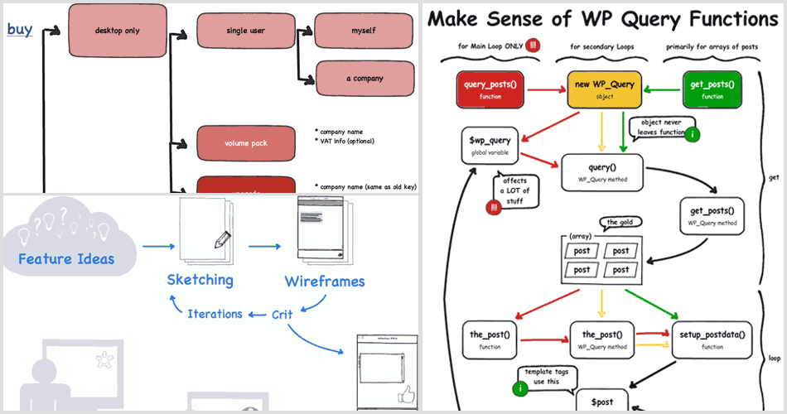
Mockup -Flowchart
http://www.rarst.net/wordpress/wordpress-query-functions/

Slide 44
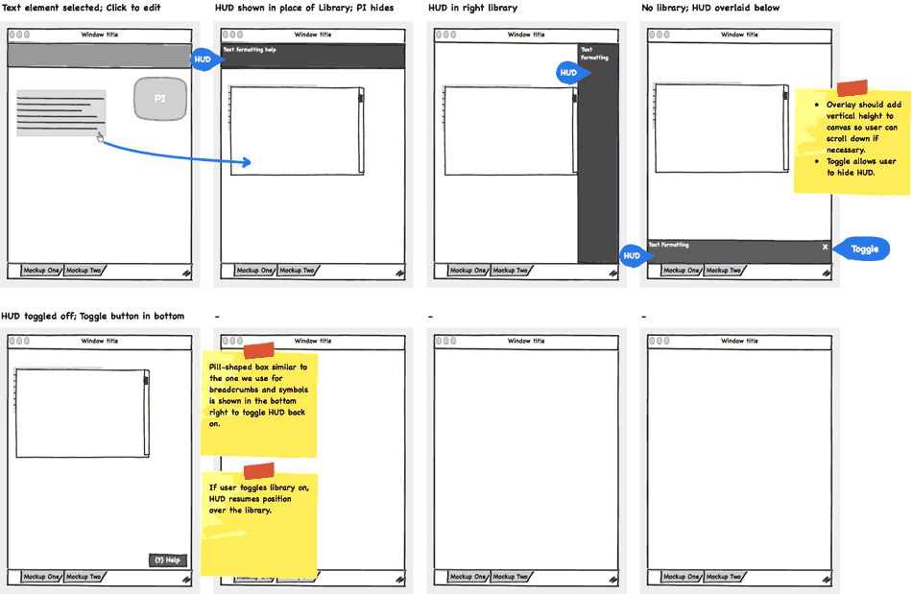
Mockup - Skecthboard
http://support.balsamiq.com/customer/portal/articles/107999

Slide 45
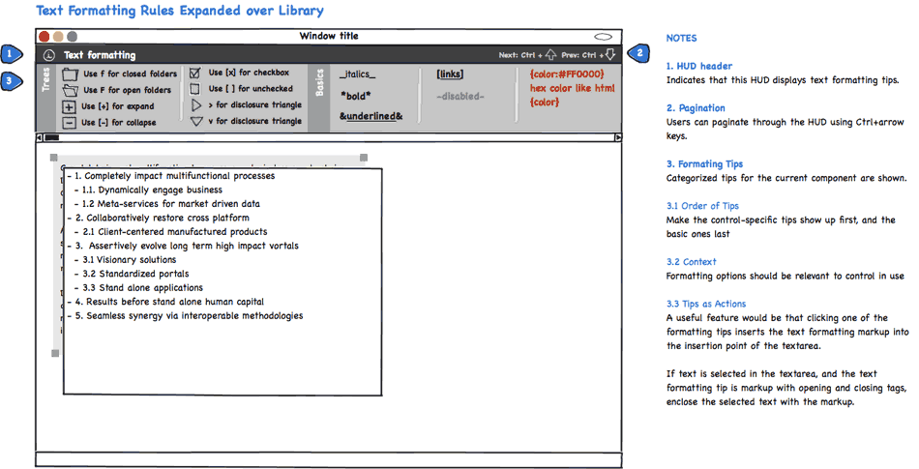
Mockup - Wireframes with annotation
http://support.balsamiq.com/customer/portal/articles/107999

Slide 46
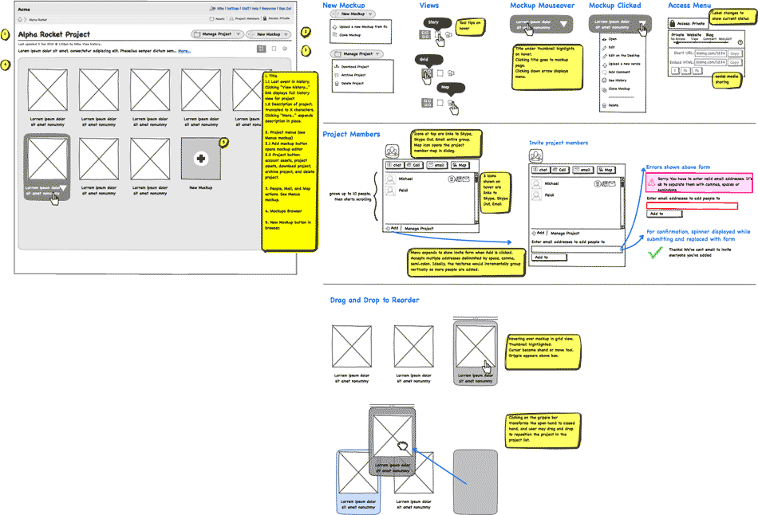
Mockup - Wireframes with ilustration flow
http://support.balsamiq.com/customer/portal/articles/107999

Slide 47
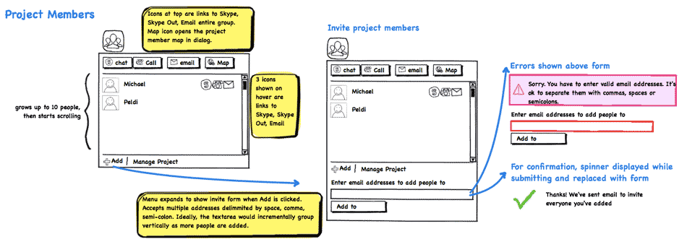
Mockup - Storyboard
http://support.balsamiq.com/customer/portal/articles/107999

Slide 48
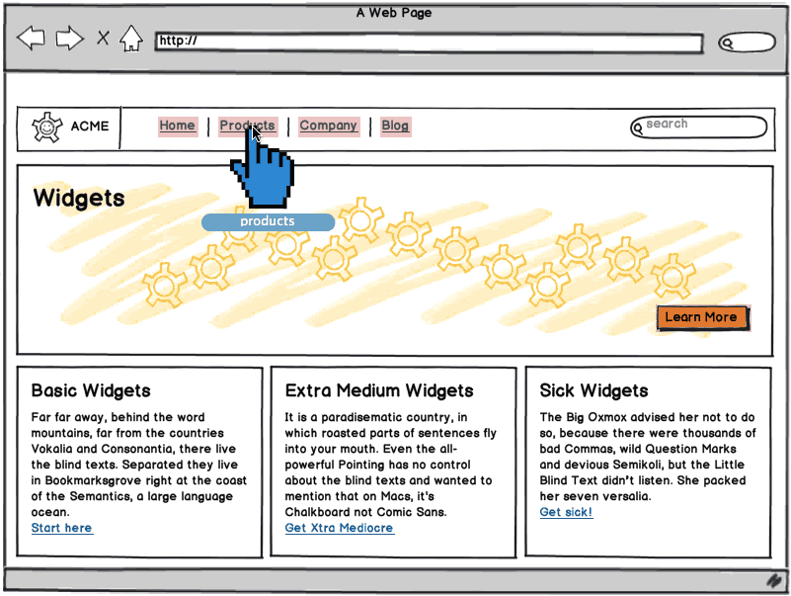
Mockup - Click-through Prototypes with Links
http://support.balsamiq.com/customer/portal/articles/107999

